Slide 1


A Terragni
Case Study
Driving App Adoption in Life Insurance
TERRAGNI CONSULTING (P) LTD PRIVATE AND CONFIDENTIAL

Slide 2
Note
The following extract is from a larger consulting project.
The app was one part of the project.
A project for only the app would involve a shorter methodology as follows:
A probe of the communication artefacts, a small insight exercise into the current adopters of the app to understand the context, adoption and continued usability insights: perceived usefulness, perceived ease of use and attitude towards app and brand. The STEPPS* framework for virality will be used.
*Jonah Berger, 2013.
TERRAGNI CONSULTING (P) LTD PRIVATE AND CONFIDENTIAL

Slide 3

Client Background
Challenge
What We Did
Barriers
Framework
Solutions
Business Outcomes
Top 4
638
Players In Private Life Insurance Sector
Offices pan India
A Large Workforce Of Insurance Advisors And Other Channel Intermediaries
TERRAGNI CONSULTING (P) LTD PRIVATE AND CONFIDENTIAL

Slide 4

Client Background
Challenge
What We Did
Barriers
Framework
Solutions
Business Outcomes
Customer engagement, retention and growth
Majority of the customers do not see the relevance of an insurance app, unclear on what the benefits are and therefore averse to downloading the app
More than 63% of customers are not aware or not comfortable with digital payment gateways for insurance related transactions
Lack of information about insurance as a product category & financial instrument
TERRAGNI CONSULTING (P) LTD PRIVATE AND CONFIDENTIAL

Slide 5


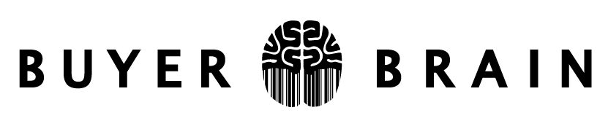
Client Background
Challenge
What We Did
Barriers
Framework
Solutions
Business Outcomes
Barriers to engagement with Insurance
Emotions and attitudes associated with the product category & their impact on customer behaviour
Barriers to engagement with an app exclusively for insurance
  Emotions and attitudes associated with the brand, product & touchpoints & their impact on customer behaviour
Barriers to engagement with the Brand
  Emotions and attitudes associated with the brand, product & touchpoints & their impact on customer behaviour
TERRAGNI CONSULTING (P) LTD PRIVATE AND CONFIDENTIAL

Slide 6
^{Quantitative Insights}
Client Background
Challenge
What We Did
Barriers
Framework
Solutions
Business Outcomes
¹
^{2 lakh+ Records –}
^{3 Years Time Span}
^{Qualitative Insights}
²
Phenomenological in depth interactions for episodic recall.
One-on-One in-depth interactions,
50 hours of interview transcripts
Consumer Neuroscience Based Widespan Assessment
³
^{Released to all the customer}
online studies testing: Trustworthiness, Touch Points Interaction Friction, Redemption Insights
TERRAGNI CONSULTING (P) LTD PRIVATE AND CONFIDENTIAL

Slide 7

Client Background
Challenge
What We Did
Barriers
Framework
Solutions
Business Outcomes
Customers have the perception that life insurance is relevant only during premium payments
Lack of goal-relevance and self-relevance with a life insurance app
Lack of motivation to explore the app due product category
Primed by cross-functional expectations that the insurance app will not be useful as compared to a banking, shopping or other frequently used apps
TERRAGNI CONSULTING (P) LTD PRIVATE AND CONFIDENTIAL

Slide 8
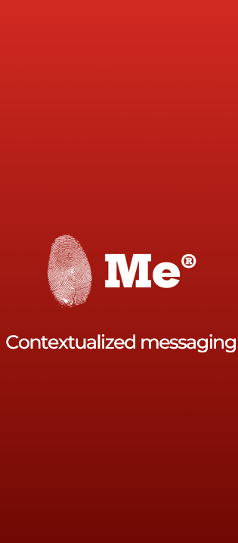
Behaviour Science Led Communication
Me is a ready-to-go behaviour science-based platform. The art of communication infused with the magic of behaviour science. Understand behaviours to strike the right chord, shift behaviours and deliver impact.
TERRAGNI CONSULTING (P) LTD PRIVATE AND CONFIDENTIAL ©

Slide 9
Solutioning Framework:
Relevant and timely nudges in the communication about the app to drive customer behaviour shifts (EAST* framework for behaviour shifts)
EASY: Make it hassle-free, intuitive and low effort
ATTRACTIVE: Attract attention, incentivize, reward
SOCIAL: Show that most people perform the desired
behaviour. Use the power of social communities
TIMELY: Demonstrate immediate costs and benefits.
Prompt when customers are most receptive to
behaviour change
Client Background
Challenge
What We Did
Barriers
Framework
Solutions
Business Outcomes
TERRAGNI CONSULTING (P) LTD PRIVATE AND CONFIDENTIAL

Slide 10

Client Background
Challenge
What We Did
Barriers
Framework
Solutions
Business Outcomes
STEPPS* Framework
Social Currency: People share things that make them look good or exclusive.
Triggers: External cues prompt people to talk about certain topics.
Emotion: Strong emotions, positive or negative, make content more shareable.
Public: Observable behaviors encourage others to imitate.
Practical Value: Useful information gets shared to help others.
Stories: Relatable narratives stick and are easily shared.
*Jonah Berger, 2013.
TERRAGNI CONSULTING (P) LTD PRIVATE AND CONFIDENTIAL

Slide 11

Client Background
Challenge
What We Did
Barriers
Framework
Solutions
Business Outcomes
Self-Relevance & Goal-Relevance to drive registration and usage of the app:
Creating messaging with emphasis on Safety, Convenience, Value Addition and Educational Content
Removing Perceived Friction about insurance app surrounding safety and benefits:
Awareness campaigns around individual benefits of the app for e.g updating personal details with emphasis on safety
App recommendation through branch and website touchpoints
TERRAGNI CONSULTING (P) LTD PRIVATE AND CONFIDENTIAL

Slide 12

Client Background
Challenge
What We Did
Barriers
Framework
Solutions
Business Outcomes
⬆Increased App Registrations
⬆Increased App Usage
⬇Reduced Cost of Service
⬆Enhanced Customer Connect and Contactability
TERRAGNI CONSULTING (P) LTD PRIVATE AND CONFIDENTIAL

Slide 13



India
London
Bucharest
www.terragni.in
www.buyerbrain.com

Slide 14
dipti@terragni.in
+91 89569 82522
Thank You

